Slide 1
Group 3
Project 1
Predicting Cifar-10 Using CNN , Transfer learning
Team Members:
Essa - Razzan - Malak - Abdulaziz

Slide 2

Objective
This project implements a Convolutional Neural Network (CNN) with transfer learning to classify images from the CIFAR-10 dataset. It includes data preprocessing, model training, and performance evaluation using key metrics like accuracy, precision, and confusion matrix.

Slide 3
Overview
Convolutional neural network (CNN)
Transfer learning
Data preprocess
Data preprocess
Load the dataset
Load the dataset
Normalize the data
Normalize the data
Data augmentation
Data resizing
Data augmentation
Modeling
Modeling
Design CNN architecture
Use pretrained model
Train the data
Design TR architecture
Train the data
Evaluation
Report metrics: accuracy, precision, recall, and F1-score.
Evaluation
Visualize the confusion matrix
Report metrics: accuracy, precision, recall, and F1-score.
Visualize the confusion matrix

Slide 4
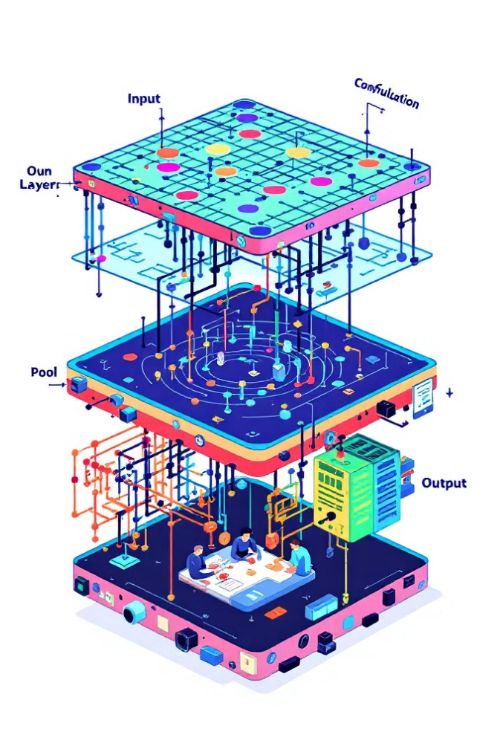
Convolutional neural network (CNN)

Slide 5

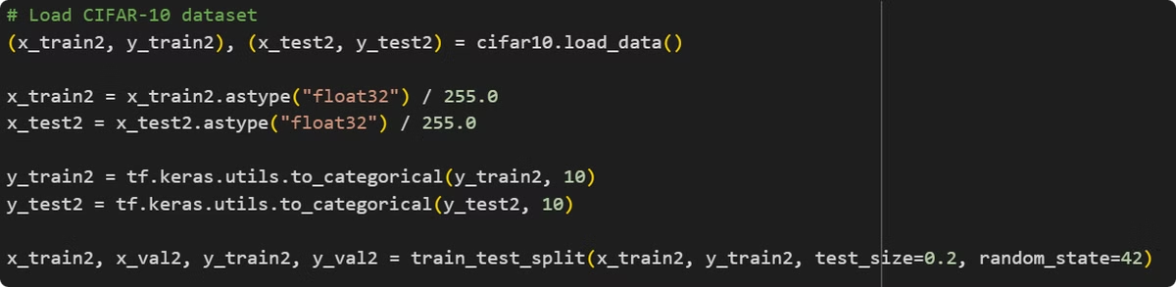
CNN data preprocess
Load CIFAR-10 dataset Normalize pixel values to range [0,1] Convert labels to one-hot encoding

Slide 6

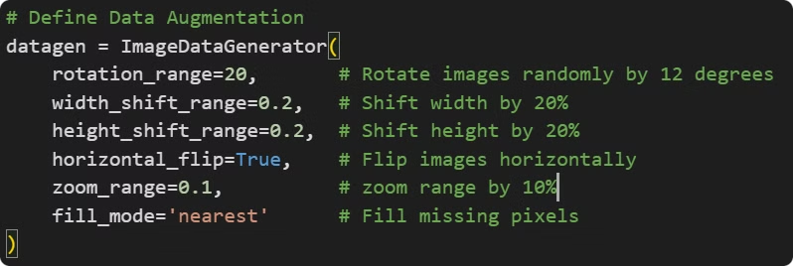
CNN data Augmentation

Slide 7

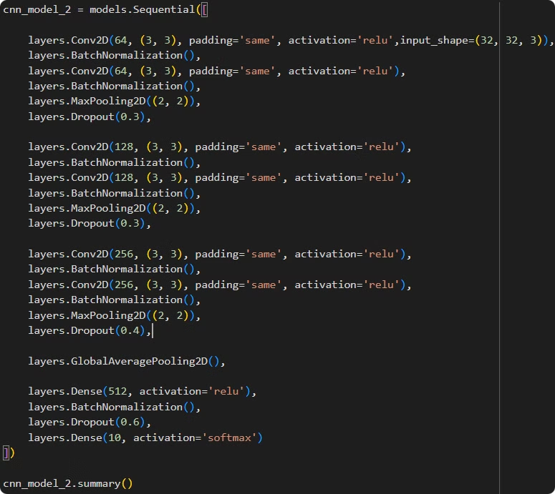
CNN desing model architecture

Slide 8

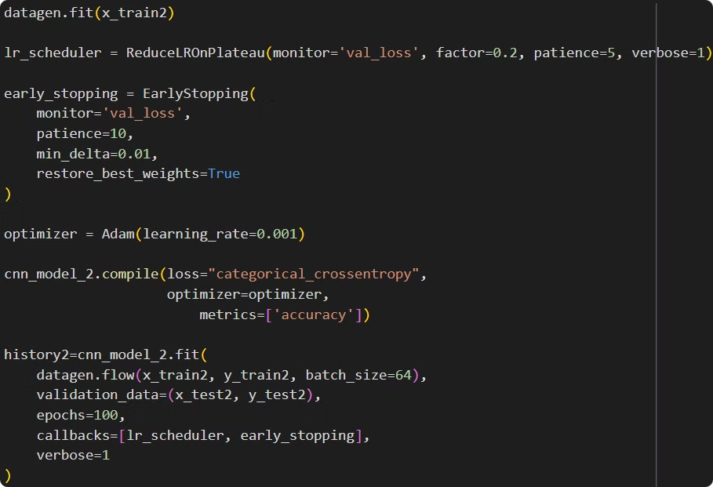
CNN, start train the data

Slide 9

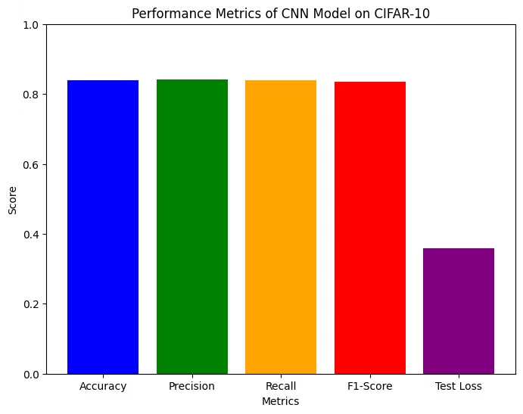
Evaluate 'CNN' model_1

Slide 10

Evaluate 'CNN' model_2

Slide 11
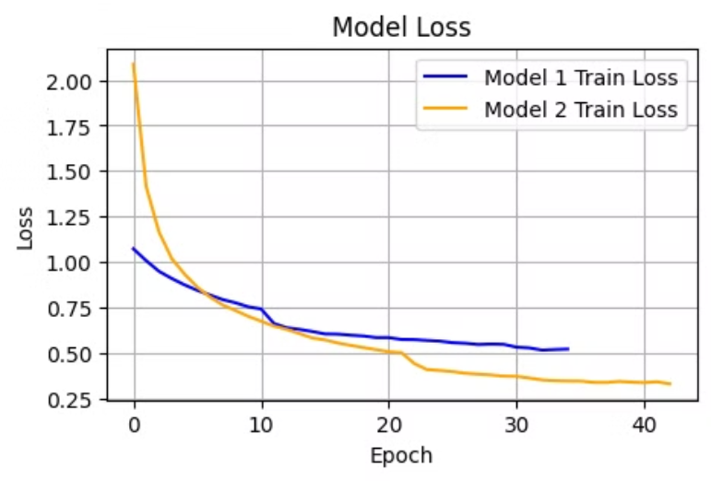
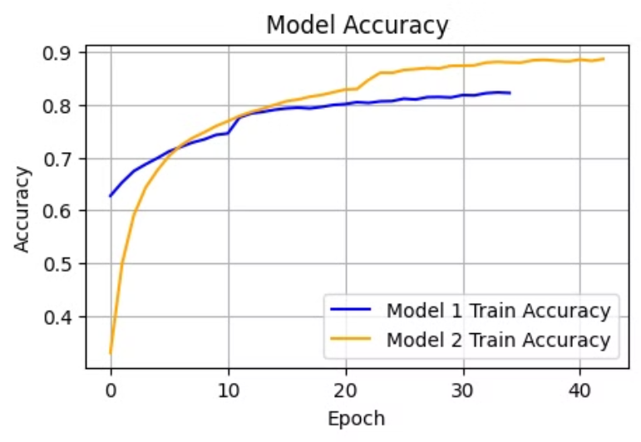
Compare between the models

Slide 12

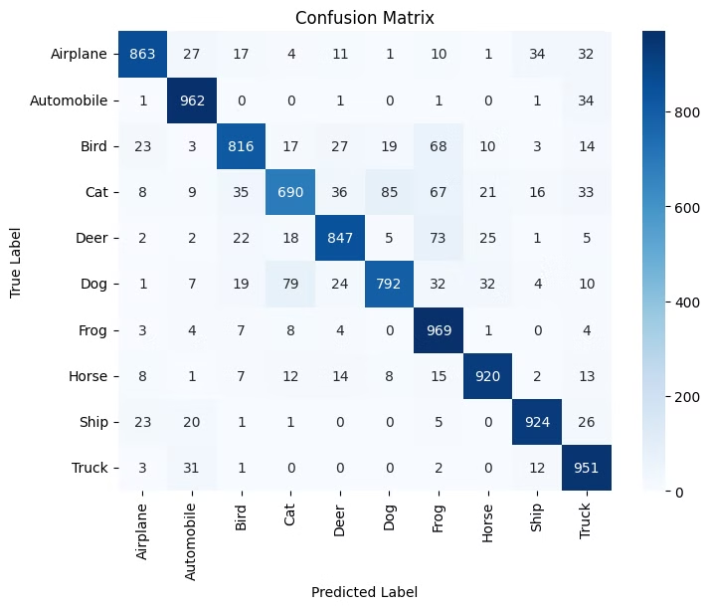
Best model confusion matrix

Slide 13


Slide 14

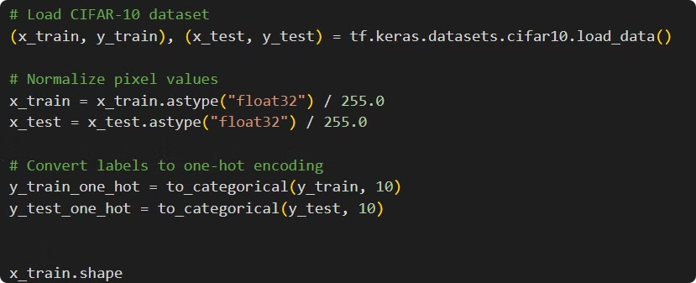
Transfer Learning data preprocess
Load CIFAR-10 dataset Normalize pixel values to range [0,1] Convert labels to one-hot encoding

Slide 15

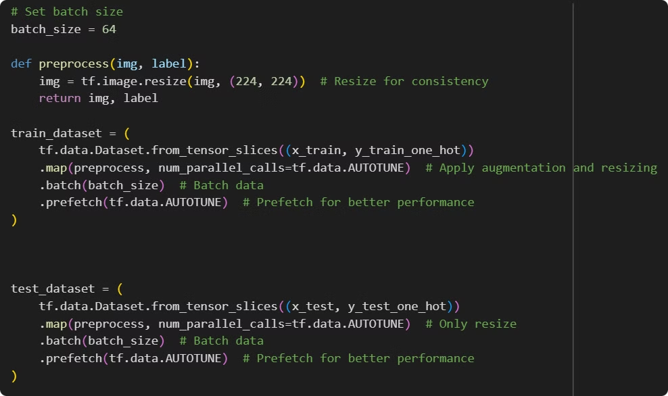
Transfer learning data resizing

Slide 16

Transfer learning 'MobileNetV2' pretrained model

Slide 17

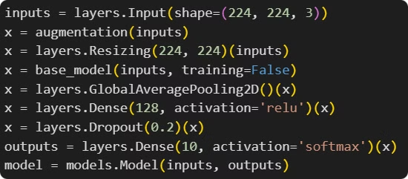
CNN desing model architecture

Slide 18

Transfer learning, start train the data

Slide 19

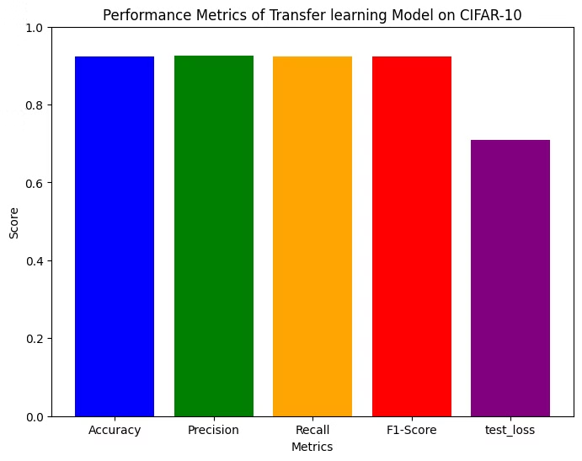
Evaluate transfer learning model

Slide 20
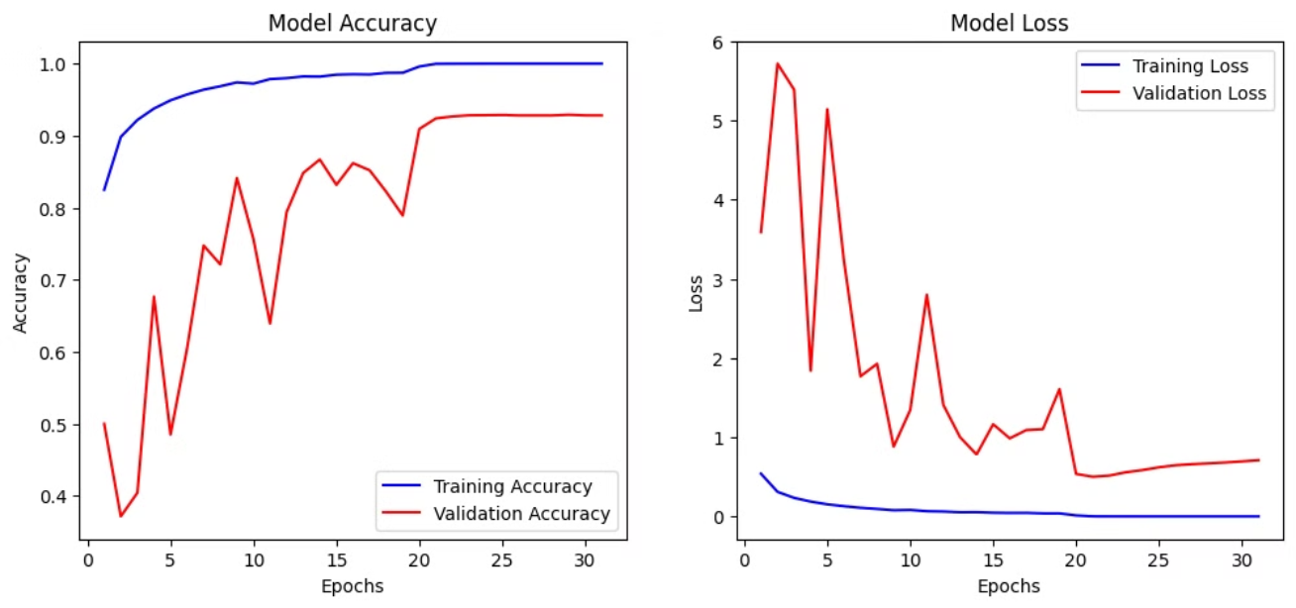
transfer learning model, accuracy and loss

Slide 21

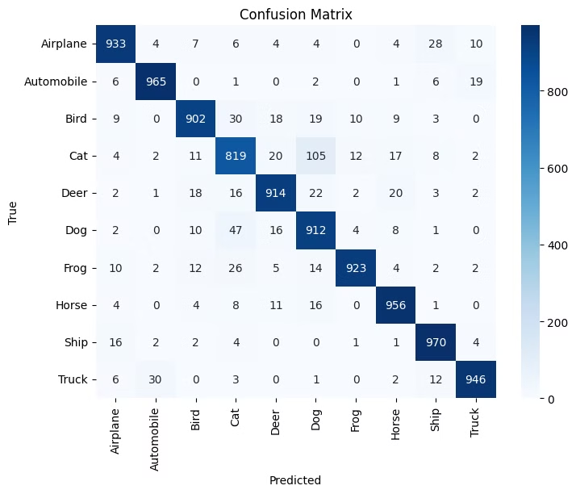
Transfer learning model confusion matrix

Slide 22

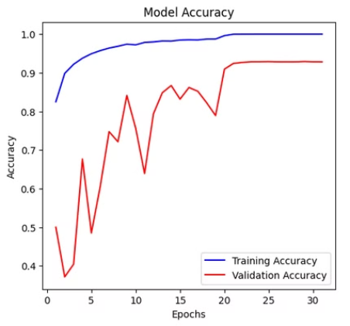
Compare models
Cnn model
Transfer learning model

Slide 23
The best model
Transfer learning model

Slide 24
Thank you
any Qustions?

